Slide 1
Aviation KPIs Analysis & Model Evaluation
Predicting Aviation Key Performance Indicators (KPIs) using Machine Learning
Shraddha s – fd39_103
Date : 28/02/2025

Slide 2
Project Overview
Develop a robust ML model to predict flight profitability (USD) based on historical performance data.
We aim to build a Linear Regression & Random Forest model to predict key metrics.
Handle real-world uncertainties like seasonal fluctuations and operational inefficiencies.
The goal is to improve aviation performance & decision-making based on predictions.
Expected Outcome - High prediction accuracy and actionable insights for airline operators.

Slide 3
Dataset Overview
Dataset Name: Aviation_KPIs_dataset
Content:200,000 entries AND 18 columns featuring operational and financial metrics.
Operational: Flight delays, aircraft utilization, turnaround time, load factor, fleet availability, maintenance downtime, fuel efficiency.
Financial: Revenue, operating cost, ancillary revenue, debt-to-equity ratio, revenue per ASK, cost per ASK, profit (target).
Our model helps in predicting key aviation metrics and provides insights into performance trends

Slide 4
Data Preprocessing
Handling Missing Values: No missing values found.
Feature Engineering: Extracted time-based features (e.g., day of week, hour from scheduled/actual departure times).
Calculated departure delay (difference between actual and scheduled times).
Data Transformation: Dropped non-informative columns (e.g., Flight Number).
Scaled numerical features using StandardScaler.
Visualization: Show a snippet of the processed data table.

Slide 5
Exploratory Data Analysis (EDA)
Visualize distributions and correlations Identify relationships between features and profitability.
Revenue vs. Profit: Strong positive relationship, as expected.
Operating Cost vs. Profit: Higher costs reduce profits, confirming a negative correlation.
Fleet Availability vs. Profit: More available aircraft contribute to better profitability.
Maintenance Downtime vs. Profit: Longer downtime reduces profit, reinforcing the negative impact.

Slide 6
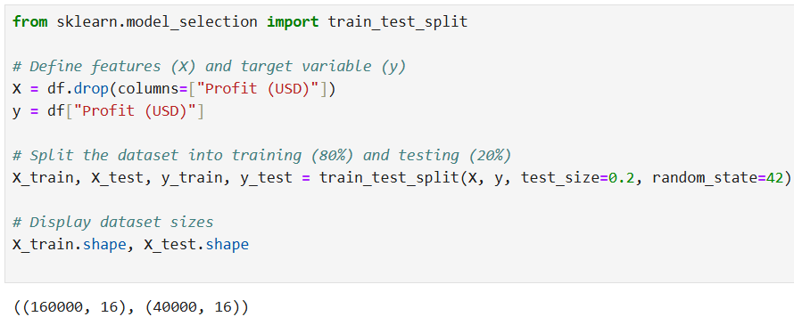
rain-Test Split and Data Preparation
Splitting Data: 80% Training and 20% Testing.
Addressing Data Types :Converted categorical data (if any) using one-hot encoding.
Ensured numeric consistency for model training.

Slide 7
Model Development
Models Tested:
Linear Regression (Baseline): Simple and interpretable
Random Forest Regressor: Handles non-linearity and gives better performance
We used Linear Regression for basic trend prediction and Random Forest for better accuracy
Evaluation Metrics: Mean Absolute Error (MAE) , Mean Squared Error (MSE), R² Score
Linear Regression: MAE ~ 3.62e-11, MSE ~ 2.03e-21, R² = 1.0
Random Forest: MAE = 41.34, MSE = 2876.70, R² = 0.99999
Both models performed well, but Linear Regression may be overfitting, whereas Random Forest is more robust.

Slide 8
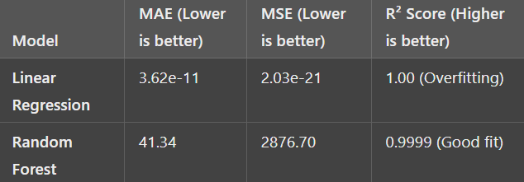
Model Comparison
Perfect metrics for Linear Regression might indicate potential overfitting or data leakage.
Random Forest shows strong performance with minimal error, offering robustness.

Slide 9
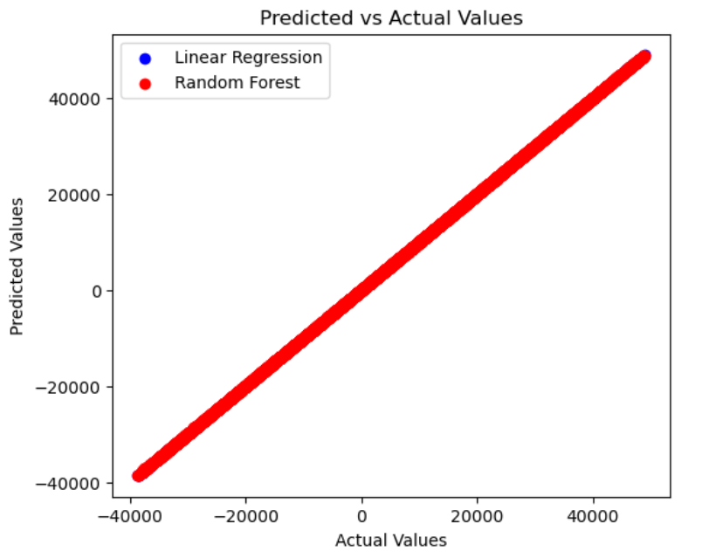
Visualization of Predictions
Plot the predicted vs. actual values for both models.
If points fall close to a diagonal line, the model is accurate.
Linear Regression may show a perfect line due to overfitting.
Our visualization shows that Random Forest provides more stable predictions.

Slide 10
Model Interpretation and Feature Importance
Use Random Forest feature importance to identify key drivers of profit.
Visualize the top features influencing profitability.
Aviation KPI Prediction: Helps airlines forecast key metrics.
Decision Making: Improves airline operations by identifying crucial factors.
Model Performance: Random Forest is the best model for real-world predictions.
"Our model can help airlines optimize operations by accurately forecasting key performance metrics.

Slide 11
Challenges & Improvements
Challenges & Limitations
Future Improvements
Challenges Faced:
✔️ Data preprocessing (handling missing values, categorical data) ✔️ Linear Regression overfitting issue ✔️ Ensuring the dataset had balanced features
Challenges included handling missing data, categorical variables, and preventing overfitting
✔️ Use XGBoost or Deep Learning for better accuracy ✔️ Collect more diverse data to improve predictions ✔️ Tune hyperparameters to prevent overfitting
Future work includes testing more advanced models like XGBoost and collecting additional data

Slide 12
Conclusion & Final Takeaways
We successfully built & evaluated two models (Linear Regression & Random Forest).
Random Forest performed best with realistic accuracy.
This project helps the aviation industry optimize performance.
This project provided valuable insights into aviation KPIs and how to optimize them using ML models.

Slide 13
Thank you

